Slide 1
CHGM-141
General and Analytical Chemistry I
Lecture 19
(Ch. 7) with Dr. Bailey
Aqueous Reactions
Precipitation Reactions
Acid-Base Reactions
Titration
Gas Evolving Reactions

Slide 2

EXCHANGE: Precipitation Reactions
EXCHANGE
Gas-Forming
Reactions
EXCHANGE
Acid-Base
Reactions
REACTIONS
REDOX REACTIONS

Slide 3
Precipitation Reactions
reactions between aqueous solutions of ionic compounds that produce an ionic compound that is insoluble in water are called precipitation reactions and the insoluble product is called a precipitate
Notes:
picture from Tro Intro Chem, 2nd Ed.

Slide 4
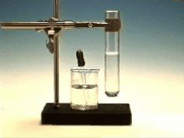
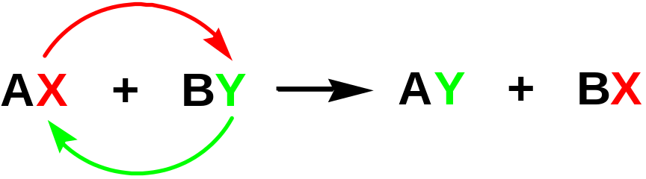
Chemical Reactions in Water
Precipitation Reactions
We will look at EXCHANGE REACTIONS
Pb(NO₃) ₂(aq) + 2 KI(aq)
→ PbI₂(s) + 2 KNO₃ (aq)
(double-replacement)
The anions exchange places between cations.
So…

Slide 5
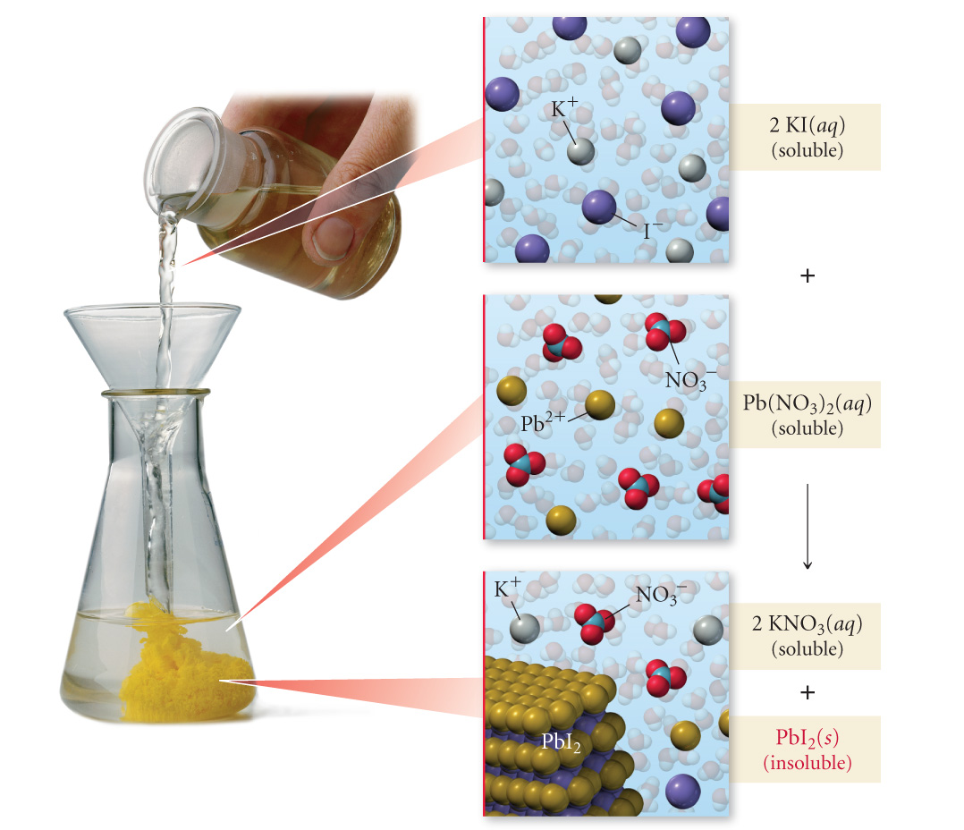
2 KI(aq) + Pb(NO₃)₂(aq) → PbI₂(s) + 2 KNO₃(aq)

Slide 6
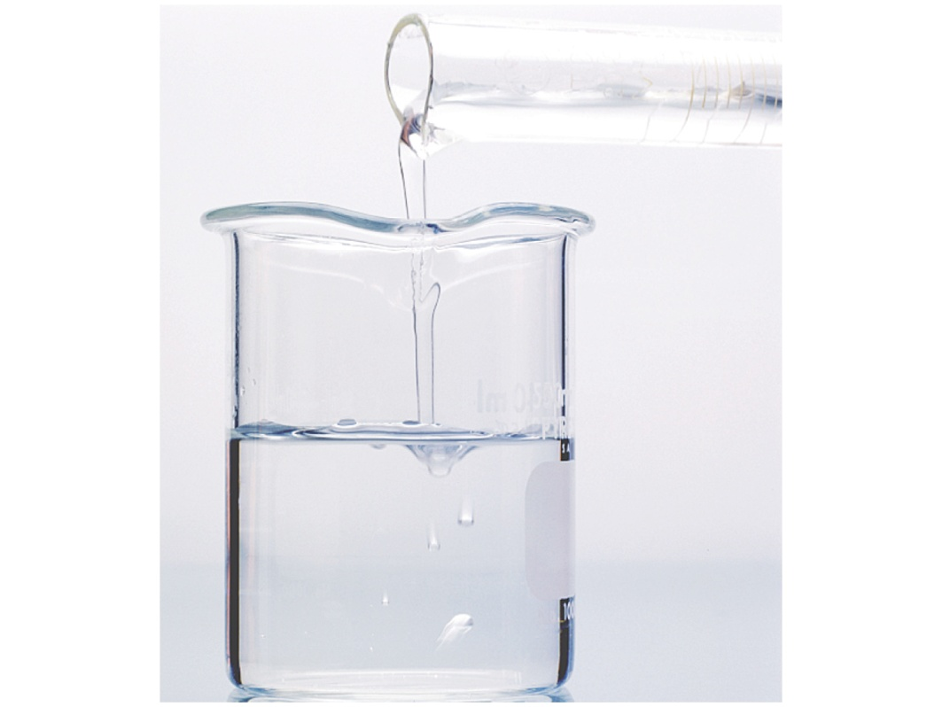
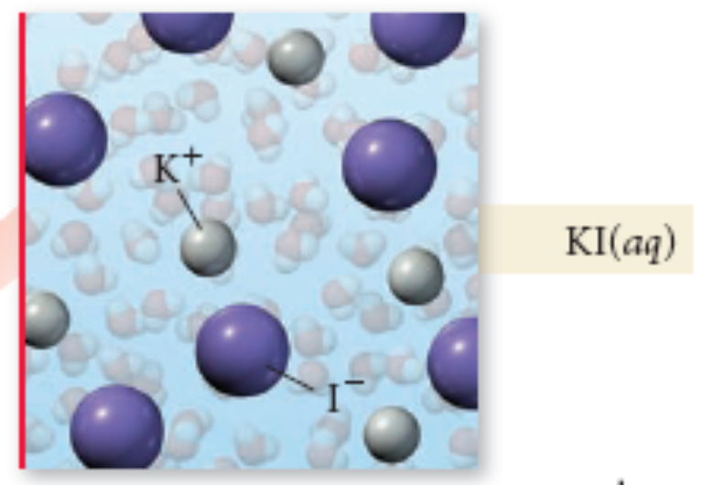
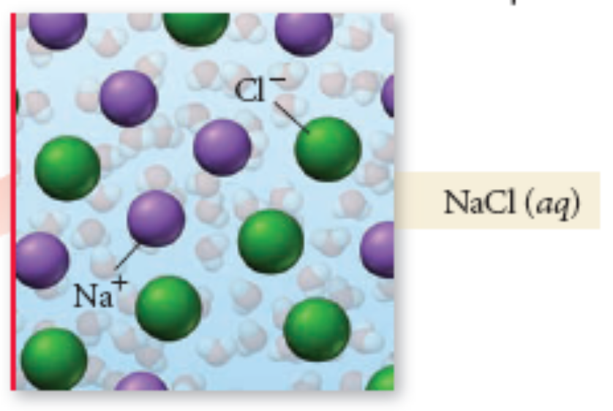
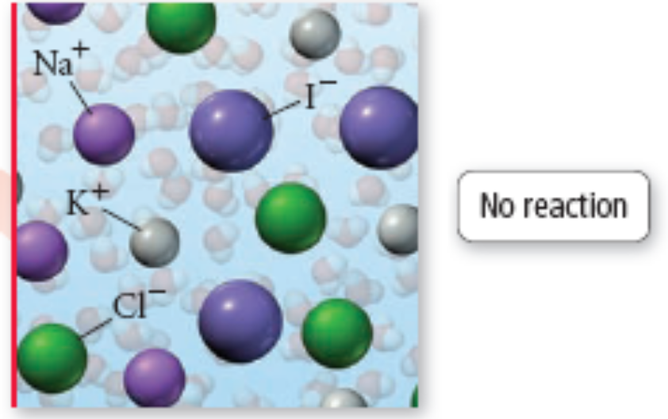
No Precipitate Formation =
No Reaction
KI(aq) + NaCl(aq) → KCl(aq) + NaI(aq)
all ions still present, ∴ no reaction
Tro, Chemistry: A Molecular Approach

Slide 7
Process for Predicting the Products of a Precipitation Reaction
2 KI(aq) + Pb(NO₃)₂(aq) → PbI₂(s) + 2 KNO₃(aq)
Determine what ions each aqueous reactant has
Determine formulas of possible products
  Exchange ions
    (+) ion from one reactant with (-) ion from other
  Balance charges of combined ions to get formula of each product
Determine Solubility of Each Product in Water
  Use the solubility rules
  If product is insoluble or slightly soluble, it will precipitate
If neither product will precipitate, write no reaction after the arrow
Tro, Chemistry: A Molecular Approach

Slide 8
Process for Predicting the Products of a Precipitation Reaction
2 KI(aq) + Pb(NO₃)₂(aq) → PbI₂(s) + 2 KNO₃(aq)
If either product is insoluble, write the formulas for the products after the arrow – writing (s) after the product that is insoluble and will precipitate, and (aq) after products that are soluble and will not precipitate
Balance the equation

Slide 9
Example – Write the equation for the precipitation reaction between an aqueous solution of potassium carbonate and an aqueous solution of nickel(II) chloride
Write the formulas of the reactants
  K₂CO₃(aq) + NiCl₂(aq) →
Determine the possible products
  Determine the ions present
  (K⁺ + CO₃²⁻) + (Ni²⁺ + Cl⁻) →
  Exchange the Ions
(K⁺ + CO₃²⁻) + (Ni²⁺ + Cl⁻) → (K⁺ + Cl⁻) + (Ni²⁺ + CO₃²⁻)
  Write the formulas of the products
    cross charges and reduce
  K₂CO₃(aq) + NiCl₂(aq) → KCl + NiCO₃

Slide 10
Example – Write the equation for the precipitation reaction between an aqueous solution of potassium carbonate and an aqueous solution of nickel(II) chloride
(Cont.)
Determine the solubility of each product
  KCl is soluble
  NiCO₃ is insoluble
If both products soluble, write no reaction
  does not apply since NiCO₃ is insoluble

Slide 11
Example – Write the equation for the precipitation reaction between an aqueous solution of potassium carbonate and an aqueous solution of nickel(II) chloride
(Cont.)
Write (aq) next to soluble products and (s) next to insoluble products
K₂CO₃(aq) + NiCl₂(aq) → KCl(aq) + NiCO₃(s)
Balance the Equation
K₂CO₃(aq) + NiCl₂(aq) → 2 KCl(aq) + NiCO₃(s)

Slide 12
Ionic Equations
equations which describe the chemicals put into the water and the product molecules are called molecular equations
2 KOH(aq) + Mg(NO₃)₂(aq) → 2 KNO₃(aq) + Mg(OH)₂(s)
equations which describe the actual dissolved species are called complete ionic equations
  aqueous strong electrolytes are written as ions
    soluble salts, strong acids, strong bases
  insoluble substances, weak electrolytes, and nonelectrolytes written in molecule form
    solids, liquids, and gases are not dissolved, therefore molecule form
2K⁺¹_{(aq)} + 2OH⁻¹_{(aq)} + Mg⁺²_{(aq)} + 2NO₃⁻¹_{(aq)} → 2K⁺¹_{(aq)} + 2NO₃⁻¹_{(aq)} + Mg(OH)_{2(s)}

Slide 13
Ionic Equations
ions that are both reactants and products are called spectator ions
2K⁺¹_{(aq)} + 2OH⁻¹_{(aq)} + Mg⁺²_{(aq)} + 2NO₃⁻¹_{(aq)} → 2K⁺¹_{(aq)} + 2NO₃⁻¹_{(aq)} + Mg(OH)_{2(s)}
an ionic equation in which the spectator ions are
removed is called a net ionic equation
2OH⁻¹_{(aq)} + Mg⁺²_{(aq)} → Mg(OH)_{2(s)}

Slide 14
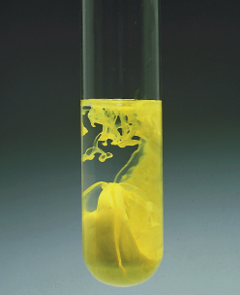
Precipitation Reactions
The “driving force” is the formation of an insoluble compound — a precipitate.
Pb(NO₃)₂(aq) + 2 KI(aq) →
2 KNO₃(aq) + PbI₂(s)
Net ionic equation
Pb²⁺(aq) + 2 I⁻(aq) → PbI₂(s)
What other driving forces might there be?

Slide 15
Acid-Base Reactions
acids ionize in water to form H⁺ ions
  more precisely, the H from the acid molecule is donated to a water molecule to form hydronium ion, H₃O⁺
    most chemists use H⁺ and H₃O⁺ interchangeably
bases dissociate in water to form OH⁻ ions
  bases, like NH₃, that do not contain OH⁻ ions, produce OH⁻ by pulling H off water molecules

Slide 16
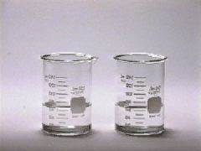
Acid-Base Reactions
These acid-base neutralization reactions are double-replacement (exchange) reactions just like the precipitation reactions:
The “driving force” is the formation of water.
HCl(aq) + NaOH(aq) → NaCl(aq) + H₂O(liq)
acid + base → salt + water
the cation from the base combines with the anion from the acid to make the salt
HX + MOH ---> MX + H₂O
In the reaction of an acid with a base, the H⁺ from the acid combines with the OH⁻ from the base to make water

Slide 17
Acid-Base Reactions
A-B reactions are sometimes called NEUTRALIZATIONS because the solution is neither acidic nor basic at the end.
The other product of the A-B reaction is a SALT, MX.
HX + MOH ---> MX + H₂O
M^{n+} comes from base & X^{n-} comes from acid
This is one way to make compounds!

Slide 18
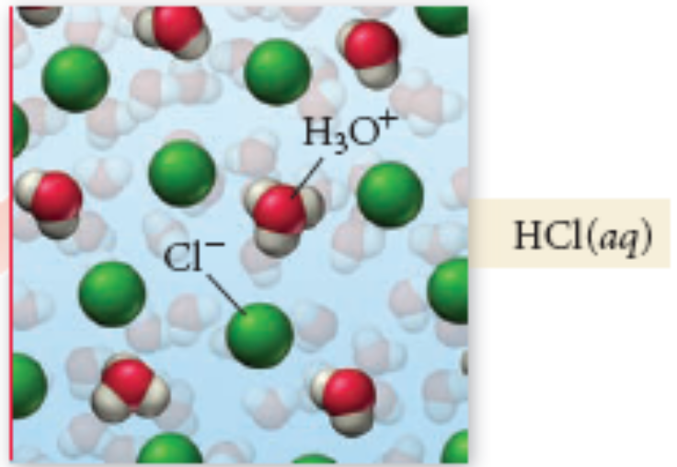
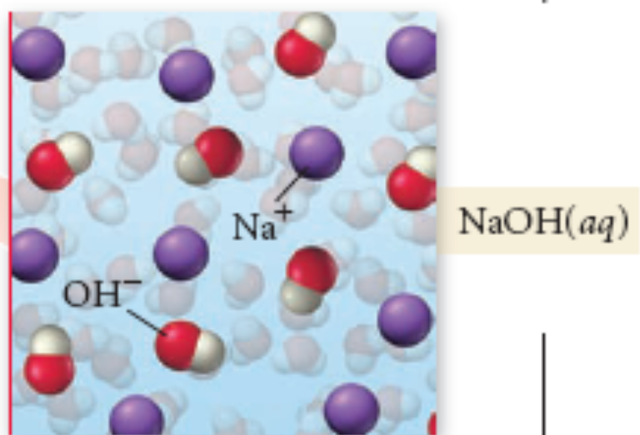
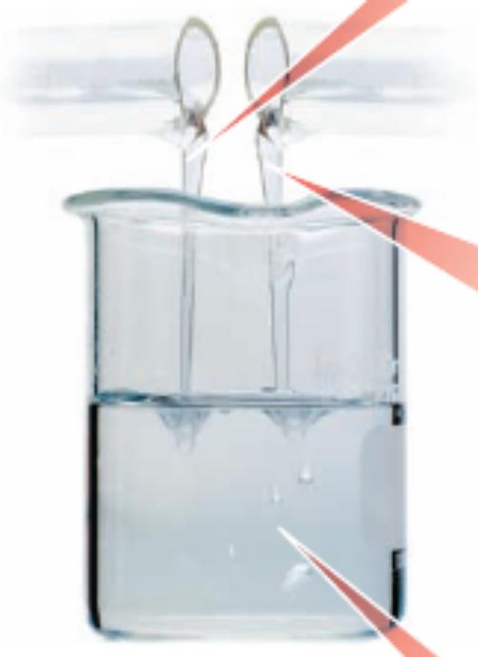
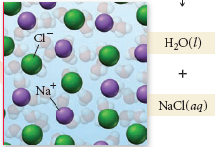
HCl(aq) + NaOH(aq) → NaCl(aq) + H₂O(l)
Tro, Chemistry: A Molecular Approach

Slide 19
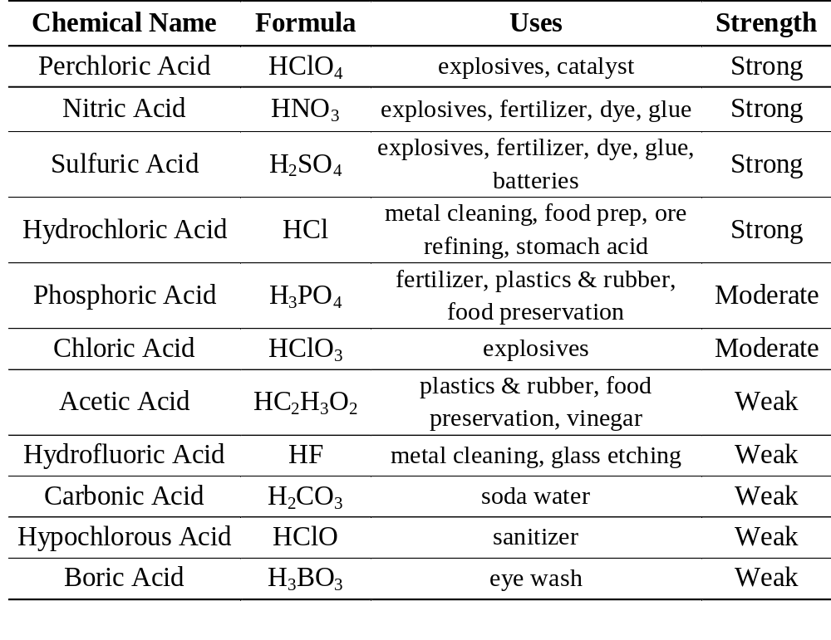
Common Acids

Slide 20
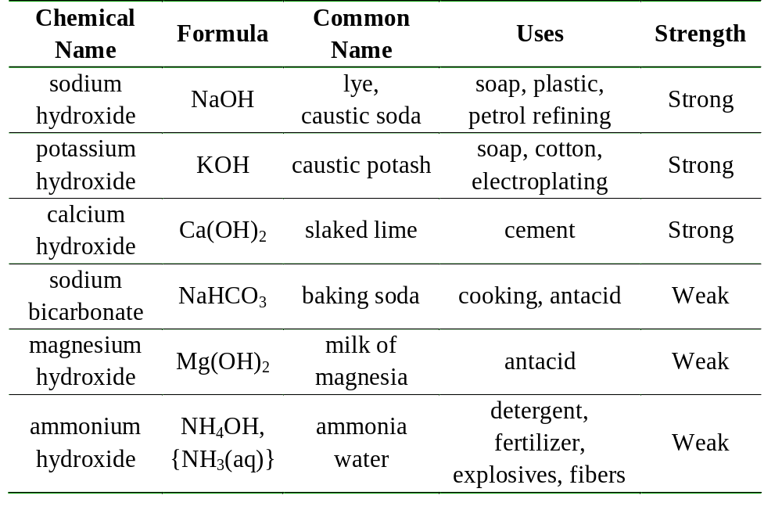
Common Bases
Tro, Chemistry: A Molecular Approach

Slide 21
Acids, Bases, and Neutralization Reactions
Write the molecular, ionic, and net ionic equations for the reaction of aqueous HBr and aqueous Ba(OH)₂.
1.
Write the chemical formulas of the products (use proper ionic rules for the salt).
HBr(aq)
+
Ba(OH)₂(aq)
H₂O
+
BaBr₂
Acid
Base
Water
Salt
Notes:
Copyright © 2010 Pearson Prentice Hall, Inc.
The order the products are written in is irrelevant.
The products will be water and a salt.
The salt is written using the rules for naming ionic compounds as previously used.

Slide 22
Acids, Bases, and Neutralization Reactions
Write the molecular, ionic, and net ionic equations for the reaction of aqueous HBr and aqueous Ba(OH)₂.
2.
Molecular Equation: Balance the equation and predict the solubility of the salt in the products.
2 HBr(aq) + Ba(OH)₂(aq)
2 H₂O(l) + BaBr₂(aq)
Use the solubility rules.
Notes:
Copyright © 2010 Pearson Prentice Hall, Inc.

Slide 23
Acids, Bases, and Neutralization Reactions
Write the molecular, ionic, and net ionic equations for the reaction of aqueous HBr and aqueous Ba(OH)₂.
3.
Ionic Equation: Dissociate a strong acid and the soluble ionic compounds.
2 HBr(aq)
Ba(OH)₂(aq)
2 H⁺(aq) + 2 Br–(aq) + Ba²⁺(aq) + 2 OH–(aq)
2 H₂O(l) + Ba²⁺(aq) + 2 Br–(aq)
BaBr₂(aq)
Notes:
Copyright © 2010 Pearson Prentice Hall, Inc.
HBr is one of the 6 strong acids.

Slide 24
Acids, Bases, and Neutralization Reactions
Write the molecular, ionic, and net ionic equations for the reaction of aqueous HBr and aqueous Ba(OH)₂–
4.
Net Ionic Equation: Eliminate the spectator ions from the ionic equation.
2 H⁺(aq) + 2 Br–(aq) + Ba²⁺(aq) + 2 OH–(aq)
2 H₂O(l) + Ba²⁺(aq) + 2 Br⁻(aq)
2 H⁺(aq) + 2 OH–(aq)
2 H₂O(l)
or
H⁺(aq) + OH–(aq)
H₂O(l)
Notes:
Copyright © 2010 Pearson Prentice Hall, Inc.

Slide 25
Acids, Bases, and Neutralization Reactions
Write the molecular, ionic, and net ionic equations for the reaction of aqueous NaOH and aqueous HF.
1.
Write the chemical formulas of the products (use proper ionic rules for the salt).
HF(aq) + NaOH(aq)
H₂O
+
NaF
Acid
Base
Water
Salt
Notes:
Copyright © 2010 Pearson Prentice Hall, Inc.

Slide 26
Acids, Bases, and Neutralization Reactions
Write the molecular, ionic, and net ionic equations for the reaction of aqueous NaOH and aqueous HF.
2.
Molecular Equation: Balance the equation and predict the solubility of the salt in the products.
HF(aq) + NaOH(aq)
H₂O(l) + NaF(aq)
Use the solubility rules.
Notes:
Copyright © 2010 Pearson Prentice Hall, Inc.

Slide 27
Acids, Bases, and Neutralization Reactions
Write the molecular, ionic, and net ionic equations for the reaction of aqueous NaOH and aqueous HF.
3.
Ionic Equation: Dissociate a strong acid and the soluble ionic compounds.
NaOH(aq)
HF(aq) + Na⁺(aq) + OH–(aq)
H₂O(l) + Na⁺(aq) + F–(aq)
NaF(aq)
Notes:
Copyright © 2010 Pearson Prentice Hall, Inc.
HF is a weak acid. Since it dissociates only to a small degree in solution, it is not dissociated in the ionic equation.

Slide 28
Acids, Bases, and Neutralization Reactions
Write the molecular, ionic, and net ionic equations for the reaction of aqueous NaOH and aqueous HF.
4.
Net Ionic Equation: Eliminate the spectator ions from the ionic equation.
HF(aq) + Na⁺(aq) + OH–(aq)
H₂O(l) + Na⁺(aq) + F–(aq)
HF(aq) + OH–(aq)
H₂O(l) + F–(aq)
Notes:
Copyright © 2010 Pearson Prentice Hall, Inc.

Slide 29
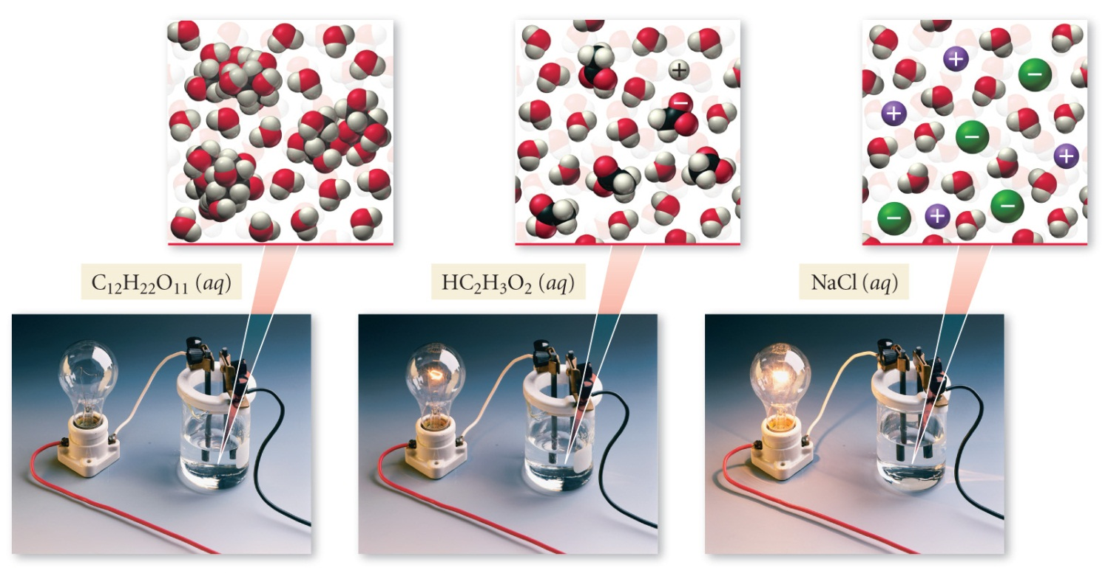
Aqueous solutions of which of the following would conduct electricity?
AgNO₃
C₁₁H₂₂O₁₁ (sucrose: table sugar)
CH₃CH₂OH (ethanol)
O₂
All of the above
None of the above

Slide 30
Aqueous solutions of which of the following would conduct electricity?
AgNO₃
C₁₁H₂₂O₁₁ (sucrose: table sugar)
CH₃CH₂OH (ethanol)
O₂
All of the above
None of the above

Slide 31
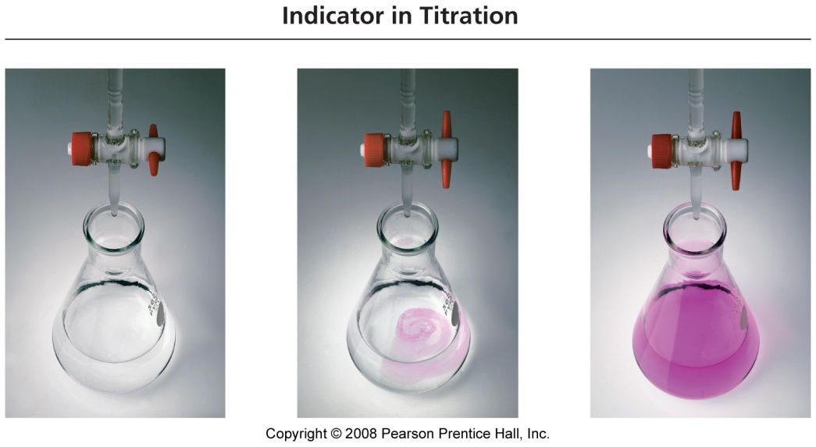
Titrations
ALL titrations work the same way:
You have an unknown amount of one compound (call it A).
You have a known amount of a different compound (call it B).
You know a chemical reaction that occurs between A and B.
Add B until no more reaction occurs.
The amount of A is stoichiometrically equivalent to B!

Slide 32
Acid/Base Titrations
How does this work for an acid/base titration?
What is the first thing we need to know?
EXACTLY! The Chemical Reaction

Slide 33
Acid-base Reaction
In an acid/base titration, the generic reaction is:
H⁺ + OH⁻ → H₂O
H₃O⁺ + OH⁻ → 2 H₂O
An acid is a proton donor (H⁺)
A base is a proton acceptor

Slide 34
H⁺ + OH⁻ → H₂O
As I make water, by adding OH⁻ to H⁺ (or H⁺ to OH⁻),
the pH changes.
How do I know that I’m done adding…?
When I reach “equivalence” (I’m “done”), the pH should be…
7 (for strong acids/bases)

Slide 35

Indicators of the endpoint
You can use a pH meter to monitor pH.
You can use chemical indicators (dyes) to monitor pH. Some dyes change color when the pH changes.
If you add a little bit of one of these dyes that changes color around pH = 7, then it will change color when you reach equivalence.

Slide 36
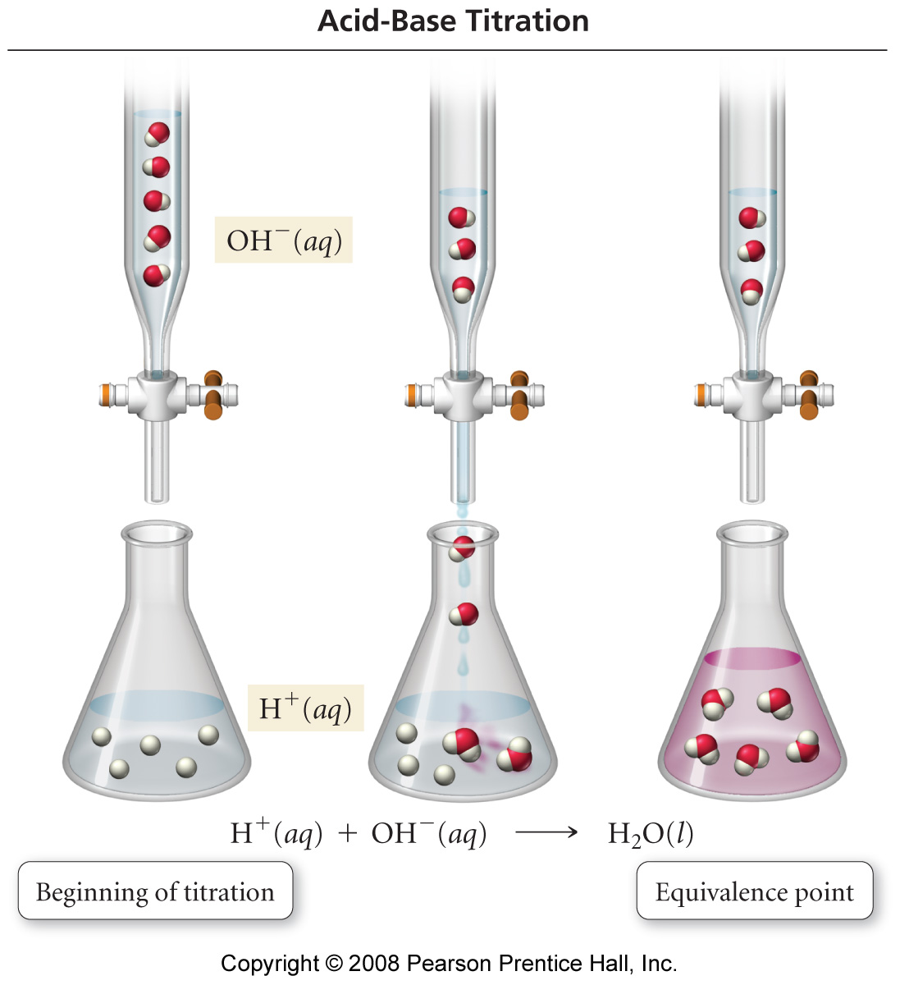
Titration
The base solution is the
titrant in the burette.
As the base is added to
the acid, the H⁺ reacts with
the OH– to form water.
But there is still excess
acid present so the color
does not change.
At the titration’s endpoint,
just enough base has been
added to neutralize all the
Acid (the reactants are in their stoichiometric ratio). At this point the
indicator changes color.

Slide 37

Watch B:
OH-
OH-
OH-
OH-
OH-
H+
H+
pH is low
(acidic)
H+
H+
H+

Slide 38
Watch B:
B
OH-
OH-
OH-
OH-
H+
pH is getting higher
A
H-OH
H+
H+
H+

Slide 39
Watch B:
B
OH-
OH-
OH-
H-OH
pH is even higher
A
H-OH
H+
H+
H+

Slide 40
Watch B:
B
OH-
OH-
OH-
H-OH
pH is even higher
A
H-OH
H-OH
H+
H+

Slide 41
Watch B:
B
OH-
OH-
OH-
H-OH
pH is near 7
A
H-OH
H-OH
H-OH
H+

Slide 42
Watch B:
B
OH-
OH-
OH-
H-OH
pH is 7
(neutral)
A
H-OH
H-OH
H-OH
H-OH

Slide 43
Watch B:
B
OH-
OH-
OH-
H-OH
pH is over 7
(basic)
A
H-OH
H-OH
H-OH
H-OH

Slide 44
pH vs. mL Base added
pH
7
mL OH- added

Slide 45
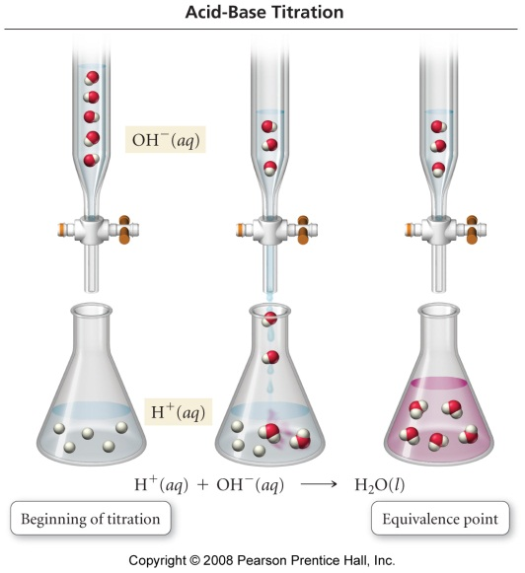
Example 4.14:
The titration of 10.00 mL of HCl solution of unknown concentration requires 12.54 mL of 0.100 M NaOH solution to reach the end point. What is the concentration of the unknown HCl solution?
Write down the given quantity and its units.
Given: 10.00 mL HCl
12.54 mL of 0.100 M NaOH
Tro, Chemistry: A Molecular Approach

Slide 46

Example 4.14:
The titration of 10.00 mL of HCl solution of unknown concentration requires 12.54 mL of 0.100 M NaOH solution to reach the end point. What is the concentration of the unknown HCl solution?
Information
Given: 10.00 mL HCl
12.54 mL of 0.100 M NaOH
Write down the quantity to find, and/or its units.
  Find: concentration HCl, M
Tro, Chemistry: A Molecular Approach

Slide 47

Example 4.14:
The titration of 10.00 mL of HCl solution of unknown concentration requires 12.54 mL of 0.100 M NaOH solution to reach the end point. What is the concentration of the unknown HCl solution?
Information
Given: 10.00 mL HCl
12.54 mL of 0.100 M NaOH
Find: M HCl
Collect Needed Equations and Conversion Factors:
  HCl(aq) + NaOH(aq) → NaCl(aq) + H₂O(l)
  1 mole HCl /1 mole NaOH
Tro, Chemistry: A Molecular Approach

Slide 48
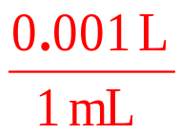
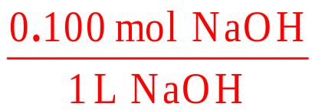
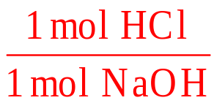
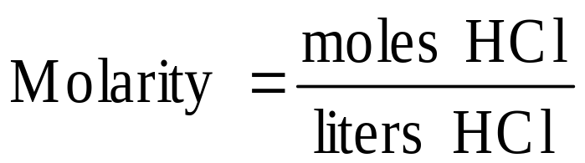
Example 4.14:
The titration of 10.00 mL of HCl solution of unknown concentration requires 12.54 mL of 0.100 M NaOH solution to reach the end point. What is the concentration of the unknown HCl solution?
Information
Given: 10.00 mL HCl
12.54 mL of 0.100 M NaOH
Find: M HCl
CF: 1 mol HCl = 1 mol NaOH
0.100 mol NaOH = 1 L
M = mol/L
Write a Concept Plan:
mL
NaOH
L
NaOH
mol
NaOH
mol
HCl
mL
HCl
L
HCl
Tro, Chemistry: A Molecular Approach

Slide 49
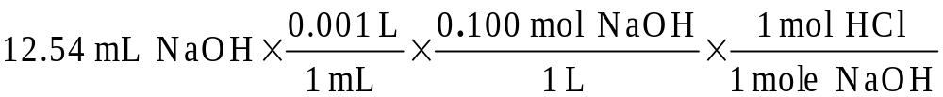
Example 4.14:
The titration of 10.00 mL of HCl solution of unknown concentration requires 12.54 mL of 0.100 M NaOH solution to reach the end point. What is the concentration of the unknown HCl solution?
Information
Given: 10.00 mL HCl
12.54 mL of 0.100 M NaOH
Find: M HCl
CF: 1 mol HCl = 1 mol NaOH
0.100 mol NaOH = 1 L
M = mol/L
CP: mL NaOH → L NaOH →
mol NaOH → mol HCl;
mL HCl → L HCl & mol ⇒ M
Apply the Solution Map:
= 1.25 x 10⁻³ mol HCl
Tro, Chemistry: A Molecular Approach

Slide 50

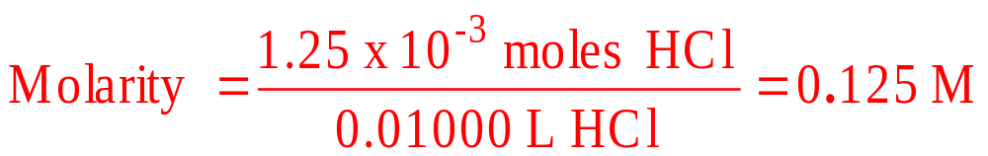
Example 4.14:
The titration of 10.00 mL of HCl solution of unknown concentration requires 12.54 mL of 0.100 M NaOH solution to reach the end point. What is the concentration of the unknown HCl solution?
Information
Given: 10.00 mL HCl
12.54 mL NaOH
Find: M HCl
CF: 1 mol HCl = 1 mol NaOH
0.100 mol NaOH = 1 L
M = mol/L
CP: mL NaOH → L NaOH →
mol NaOH → mol HCl;
mL HCl → L HCl & mol ⇒ M
Apply the Concept Plan:
HCl

Slide 51
Example 4.14:
The titration of 10.00 mL of HCl solution of unknown concentration requires 12.54 mL of 0.100 M NaOH solution to reach the end point. What is the concentration of the unknown HCl solution?
Information
Given: 10.00 mL HCl
12.54 mL NaOH
Find: M HCl
CF: 1 mol HCl = 1 mol NaOH
0.100 mol NaOH = 1 L
M = mol/L
CP: mL NaOH → L NaOH →
mol NaOH → mol HCl;
mL HCl → L HCl & mol ⇒ M
Check the Solution:
HCl solution = 0.125 M
The units of the answer, M, are correct.
The magnitude of the answer makes sense since the neutralization takes less HCl solution than
NaOH solution, so the HCl should be more concentrated.
Tro, Chemistry: A Molecular Approach

Slide 52
If you wanted to calculate the pH…?
You need to again consider stoichiometry: each HCl gives 1 proton, H+
HCl solution = 0.125 M
[H+] = [HCl]
pH = - log (0.125) = ?

Slide 53
Another Little Problem
Titration of 25.00 mL of an unknown sulfuric acid solution required 43.57 mL of 0.1956 M NaOH to reach equivalence.
What is the concentration of the sulfuric acid?
What do you need to notice about this problem?
Sulfuric Acid (H₂SO₄) is a diprotic acid.

Slide 54
If it helps…
…write the balanced equation (a chemist would).
H₂SO_{4 (aq)} + 2 NaOH _{(aq)} → Na₂SO₄ _{(aq)} + 2 H₂O _{(l)}
This is sometimes written as a “net ionic equation”:
H⁺_{(aq)} + OH⁻_{(aq)} → H₂O _{(l)}

Slide 55
Stoichiometry ALWAYS Matters
H₂SO_{4 (aq)} + 2 NaOH _{(aq)} → Na₂SO₄ _{(aq)} + 2 H₂O _{(l)}
You solve the problem (I hope…):
0.1704 M H₂SO₄
If you wanted to calculate the pH…?
You need to again consider stoichiometry: each H₂SO₄ gives 2 protons

Slide 56
H₂SO₄ → 2H+ + SO₄ -2
[H+] = 2 [H₂SO₄]
2*0.1704 M = 0.3408 M H⁺
pH = - log (0.3408) = 0.47

Slide 57
EXCHANGE: Precipitation Reactions
EXCHANGE
Gas-Forming
Reactions
EXCHANGE
Acid-Base
Reactions
REACTIONS
REDOX REACTIONS

Slide 58
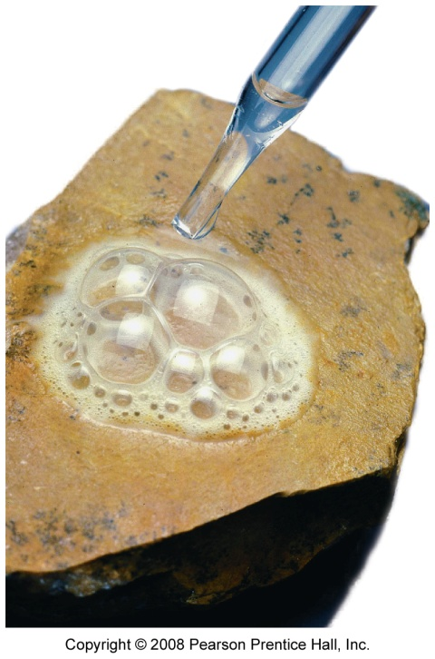
Gas Evolving Reactions
Some reactions form a gas directly from the ion exchange
K₂S(aq) + H₂SO₄(aq) → K₂SO₄(aq) + H₂S(g)
Other reactions form a gas by the decomposition of one of the ion exchange products into a gas and water
K₂SO₃(aq) + H₂SO₄(aq) → K₂SO₄(aq) + H₂SO₃(aq)
H₂SO₃ → H₂O(l) + SO₂(g)

Slide 59
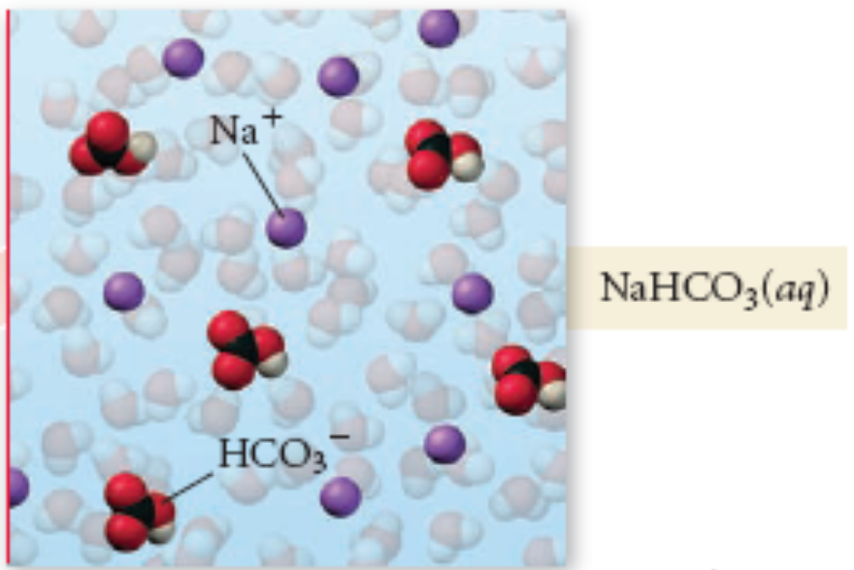
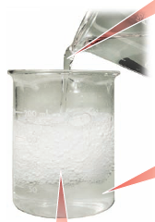
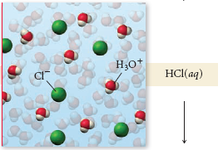
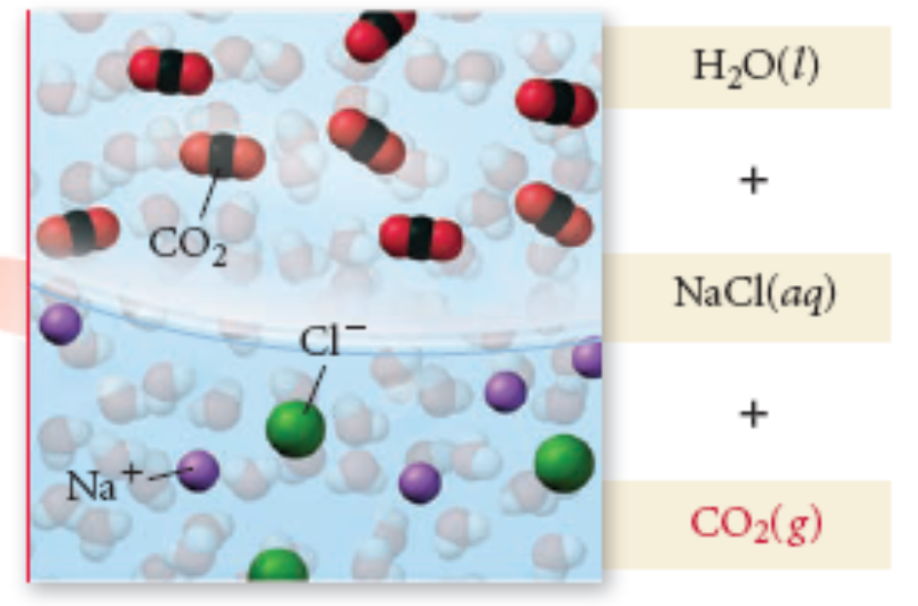
NaHCO₃(aq) + HCl(aq) → NaCl(aq) + CO₂(g) + H₂O(l)
Another Example:

Slide 60
Compounds that Undergo
Gas Evolving Reactions
Reactant Type | Reacting With | Ion Exchange Product | Decom-pose? | Gas Formed | Example
metal_{n}S, metal HS | acid | H₂S | no | H₂S | K₂S(aq) + 2HCl(aq) → 2KCl(aq) + H₂S(g)
metal_{n}CO₃, metal HCO₃ | acid | H₂CO₃ | yes | CO₂ | K₂CO₃(aq) + 2HCl(aq) → 2KCl(aq) + CO₂(g) + H₂O(l)
metal_{n}SO₃ metal HSO₃ | acid | H₂SO₃ | yes | SO₂ | K₂SO₃(aq) + 2HCl(aq) → 2KCl(aq) + SO₂(g) + H₂O(l)
(NH₄)_{n}anion | base | NH₄OH | yes | NH₃ | KOH(aq) + NH₄Cl(aq) → KCl(aq) + NH₃(g) + H₂O(l)

Slide 61
Example 4.15 - When an aqueous solution of sodium carbonate is added to an aqueous solution of nitric acid, a gas evolves
Write the formulas of the reactants
  Na₂CO₃(aq) + HNO₃(aq) →
Determine the possible products
  Determine the ions present when each reactant dissociates
  (Na⁺¹ + CO₃⁻²) + (H⁺¹ + NO₃⁻¹) →
  Exchange the anions
(Na⁺¹ + CO₃⁻²) + (H⁺¹ + NO₃⁻¹) → (Na⁺¹ + NO₃⁻¹) + (H⁺¹ + CO₃⁻²)
  Write the formula of compounds
    cross the charges
    Na₂CO₃(aq) + HNO₃(aq) → NaNO₃ + H₂CO₃

Slide 62
Example 4.15 - When an aqueous solution of sodium carbonate is added to an aqueous solution of nitric acid, a gas evolves
Check to see either product H₂S - No
Check to see if either product decomposes – Yes
  H₂CO₃ decomposes into CO₂(g) + H₂O(l)
Na₂CO₃(aq) + HNO₃(aq) → NaNO₃ + CO₂(g) + H₂O(l)

Slide 63
Example 4.15 - When an aqueous solution of sodium carbonate is added to an aqueous solution of nitric acid, a gas evolves
Determine the solubility of other product
  NaNO₃ is soluble
Write an (s) after the insoluble products and a (aq) after the soluble products
Na₂CO₃(aq) + 2 HNO₃(aq) → 2 NaNO₃(aq) + CO₂(g) + H₂O(l)
Balance the equation
Na₂CO₃(aq) + 2 HNO₃(aq) → 2 NaNO₃ + CO₂(g) + H₂O(l)
Tro, Chemistry: A Molecular Approach

Slide 64
Tro, Chemistry: A Molecular Approach

Slide 65
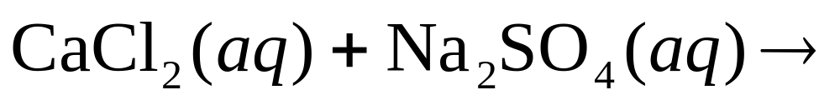
What do we see happen when we mix these two aqueous solutions?
Nothing – there is no reaction
We see the formation of a precipitate
Nothing but a neutralization reaction occurs
Nothing, but gas is evolved in a reaction
10
0
of
5

Slide 66
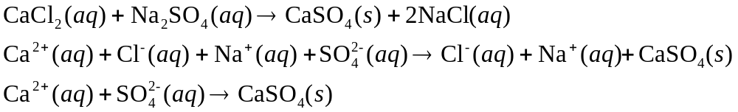
What are the coefficients for the correctly balanced ionic equation?
1, 1 and 2
1, 2 and 1
1,1 and 1
1,2,2,1,2,2, and 1
1,1,1,1,1,1, and 1
2,2,2,2,2,2, and 1
10
0
of
5

Slide 67
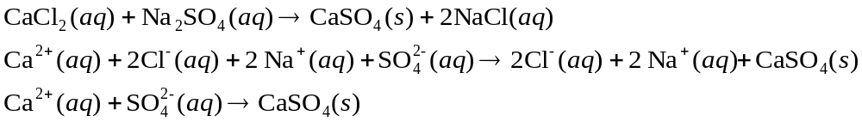
What are the spectator ions in this correctly balanced reaction?
Ca²⁺ and SO₄²⁻
Ca²⁺ and Cl⁻
SO₄²⁻ only
Na⁺ and Cl⁻
Na⁺ and SO₄²⁻
10
0
of
5

